Slide 1

E-COMMERCE SALES ANALYSIS

Slide 2
PROJECT OVERVIEW
This project analyzes key performance indicators for an e-commerce business to gain insights into its sales performance, profitability, and distribution patterns across various categories, regions and segments.

Slide 3
Key Metrics Analyzed
Overall Sales and Profit
Monthly Sales and Profit Trends
Profit per Product Category
Sales per Product Category
Sales Distribution by State and Region
Sales and Profit by Customer Segments.

Slide 4
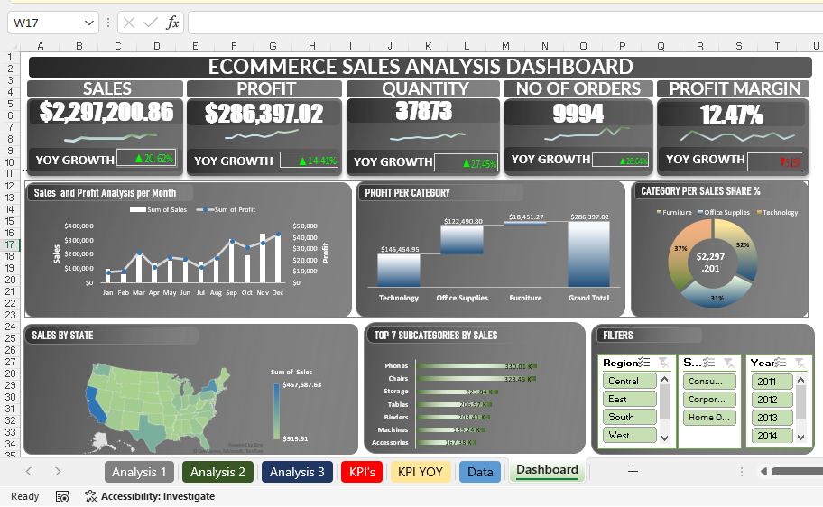
DATA ANALYSIS AND VISUALIZATION

Slide 5
GENERAL INSIGHTS
The total Sales is $2,297,200.86
The total Profit is $286,397.02
The Month with the Least Sale is February, with a total of $ 60,172.65
The Month with the Highest Sale is November, with a total of $349,120.07
The Month with the Highest Profit is December, with a total of $43,436.13
The Month with the Least Profit is January, with a total of $9,199.27
The have a profit margin of 12.47%
Technology is the Product Category with the most sales, with 37% and a figure of $836,154.03
Office Supply is the Product Category with the least sales, with 31% and a figure of $719,047.03
The Region with the Most Sale is West Region with $725,457.82
The State with the Most Sales is California with $ 457,687.63
The Region with the Least Sales is East Region with $ 391,721.91
The State with the Least Sales is North Dakota with $ 919.91

Slide 6

RECOMMENDATIONS
Focus on high-margins categories.
Strength presence in promising regions.
Targeting high-value segments.

Slide 7
CONCLUSION
This E-commerce sales analysis offers actionable insights that can optimize business performance. It provides trends in customers demands and regional performance, with distinct patterns in monthly sales and profitability. Key findings highlight that certain product categories consistently achieve higher profit margins, while specific states and regions untapped growth potentials.

Slide 8
THANK YOU

